Slide 1
CHAPTER 13
Quasi-Experiments and Small-N Designs

Slide 2
Chapter Outline
Quasi-experiments: How do quasi-experiments differ from true experiments?
Small-N designs: Studying only a few individuals
Notes:
There are two main questions to address in this chapter.
Quasi-experiments: How do quasi-experiments differ from true experiments, and when do they support causal claims?
Small-N designs: How do small-N designs differ from large-N designs, and can they support causal claims?

Slide 3
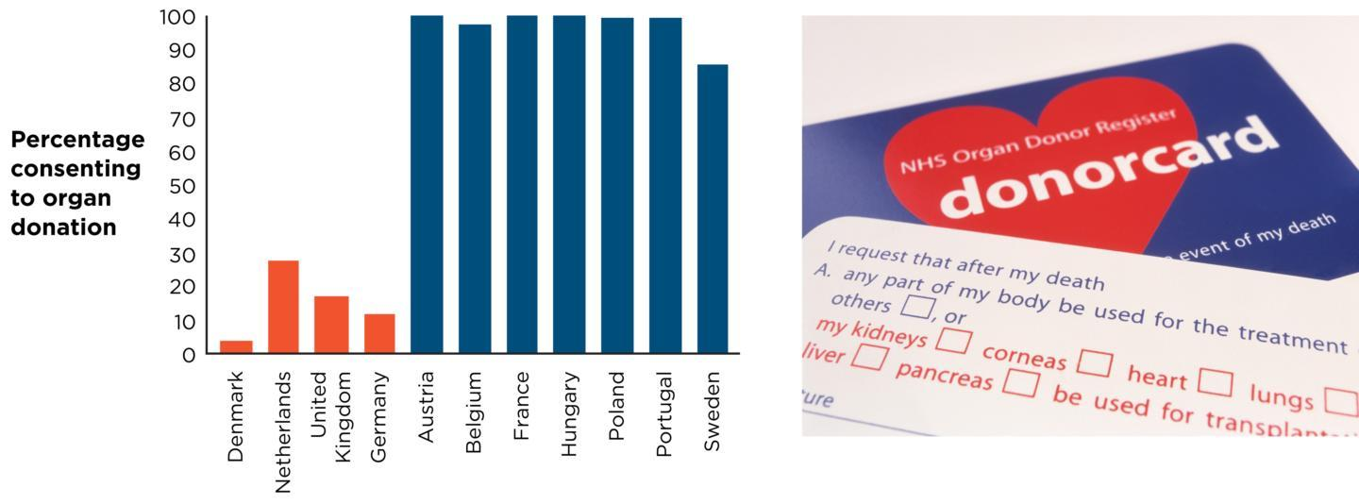
Nudging People Toward Organ Donation
Notes:
Figure 13.1: Defaults Save Lives
Some countries (red bars) require people to take action to become an organ donor; others (blue bars) require people to take action in order to opt out. The rates of organ donation in the population are much higher in countries with opt-out systems. (Source: Johnson & Goldstein, 2003.)
Organ donation options are framed differently in different countries. Some are opt-in, meaning people must take some action (like ticking a box or sending a letter) to express their intent to be an organ donor. Others use presumed consent, or opt-out, meaning people must take some action to not be a donor. Each of these options are called default options, and people are likely to accept them when making decisions because defaults are effortless (Thaler and Sunstein, 2008).
Johnson and Goldstein (2003) tested the effect of default option framing (the quasi-independent variable) on organ donation rates (the dependent variable). They collected data in 11 different European countries and found that countries with presumed consent had much higher rates of organ donation.
Because the researchers did not control which countries had which defaults and people were not randomly assigned to live in different countries, this is a quasi-experiment. The design is called a nonequivalent control group posttest-only design because the participants were not randomly assigned to groups and were tested only once, after exposure to either one level of the independent variable or the other.
(left): Republished with permission of American Association for the Advancement of Science, from “Do Defaults Save Lives?” in Science Eric J. Johnson and Daniel Goldstein, Vol 302, Issue 5649, pp. 1338–1339, © 2003; permission conveyed through Copyright Clearance Center, Inc.; (right): Cordelia Molloy/Science Source

Slide 4
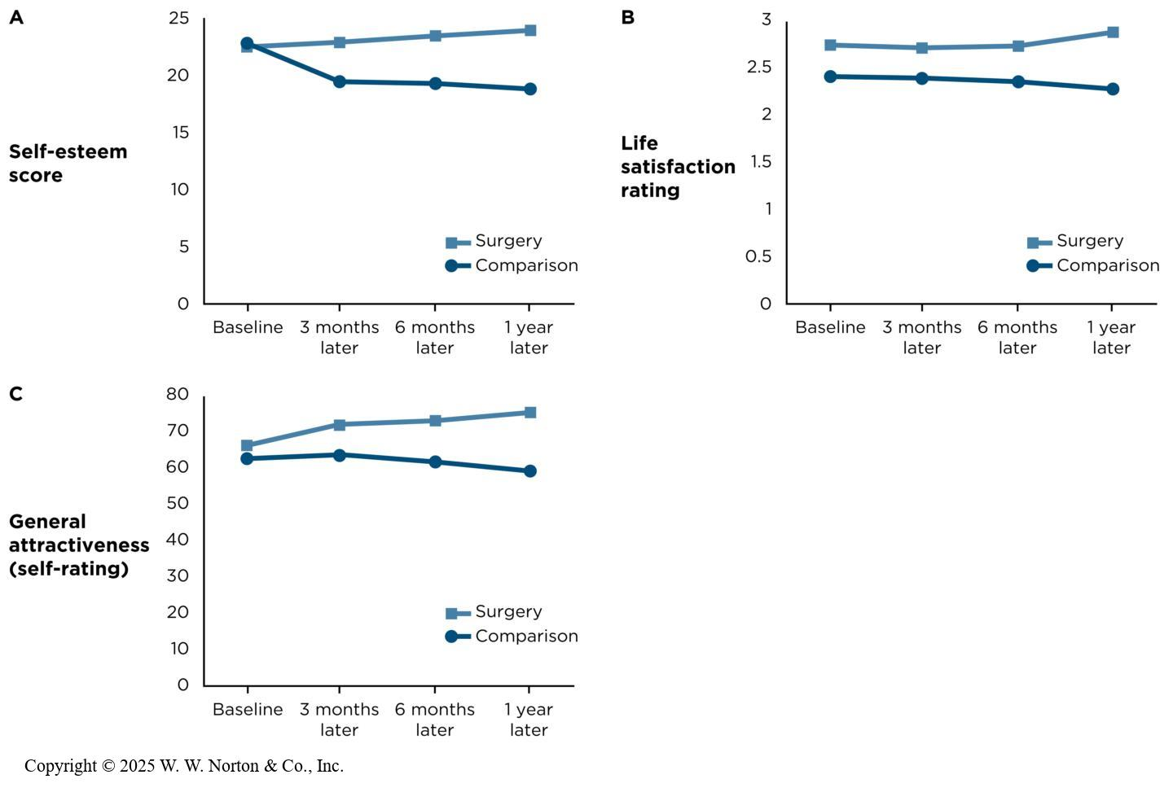
The Psychological Effects of Cosmetic Surgery
Compared self-esteem of people who underwent cosmetic surgery and people who only considered it
Notes:
Figure 13.2: Cosmetic Surgery and Well-Being
Compared with a group of people who had expressed interest in, but had not undergone, cosmetic surgery, people who had the surgery showed an increase in (A) self-esteem, (B) life satisfaction, and (C) general attractiveness. According to the results of this quasi-experiment, does cosmetic surgery work? Does it cause people to feel better about themselves? (Source: Adapted from Margraf et al., 2013. Error bars are omitted because the information was not provided in the original source.)
Among the major reasons for undergoing elective plastic surgery are to enhance self-image and increase self-esteem. A team of psychologists (Margraf, Meyer, & Lavallee, 2013) wanted to see if these effects actually occurred. Random assignment was obviously impossible. Therefore, they conducted a quasi-experiment using a treatment group of people who underwent cosmetic surgery, and for a comparison group they used people who had registered at the same plastic surgery office (thereby indicating interest) but elected not to undergo surgery.
The researchers surveyed participants at four time points: before surgery, and then 3 months, 6 months, and 1 year after surgery (making this a pretest/posttest design). They measured three different dependent variables: self-esteem, life satisfaction, and self-reported general attractiveness.
This graph shows that those who elected to have surgery reported higher levels of self-esteem afterward. (The other two variables showed a similar trend and are discussed in the book.) However, remember that no variables were manipulated. Can we say that cosmetic surgery caused a rise in self-esteem?
Copyright © 2025 W. W. Norton & Co., Inc.

Slide 5
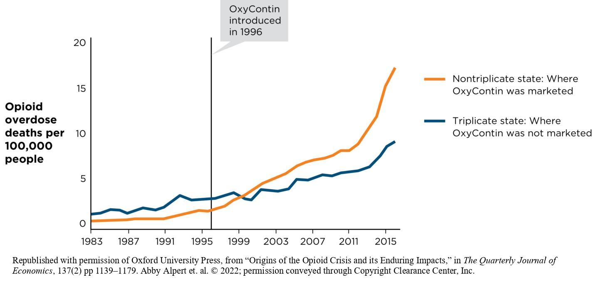
Investigating the Effect of Legislation on Opioid Abuse
Notes:
Figure 13.5: Prescription Opioid and Heroin Overdose Death Rates in Triplicate and Nontriplicate States
Before OxyContin became available, prescription opioid overdose rates were higher in triplicate states (where Purdue Pharma did not eventually market). But non-triplicate states, where Purdue Pharma decided to aggressively market OxyContin to doctors who could more easily prescribe this opioid drug, showed a steeper increase in the rate of prescription opioid overdoses after Oxycontin was introduced. (Source: Alpert et al., 2022.)
In 1996, Purdue Pharma began marketing OxyContin (a brand name for extended-release oxycodone) in the United States. People discovered ways to bypass the drug's time-release properties, leading to widespread abuse and addiction. Since then, more than 550,000 Americans have tragically died from opioid overdoses. The opioid crisis has numerous causes, including evolving medical practices surrounding pain management and economic despair. However, aggressive pharmaceutical marketing, particularly by Purdue Pharma, is thought to have played a significant role (Alpert et al., 2022).
Dr. Abby Alpert and colleagues conducted a quasi-experiment leveraging state-level variability in laws to test this hypothesis. In seven states (California, Idaho, Illinois, Indiana, Michigan, New York, and Texas), laws required doctors to file triplicate forms when prescribing Class II opioid drugs like OxyContin. These "triplicate states" discouraged doctors from prescribing Class II drugs due to the burden of additional paperwork. Purdue Pharma, aware of this barrier, chose not to market OxyContin in these states, as revealed in court documents. In contrast, nontriplicate states received aggressive marketing for OxyContin. The researchers compared triplicate and nontriplicate states, tracking opioid prescription rates and overdose death rates over time. Before 1996, opioid deaths were higher in triplicate states. However, following the release of OxyContin, deaths climbed significantly in nontriplicate states, where the drug was aggressively marketed.
This study used a nonequivalent control group interrupted time-series design, combining two quasi-experimental methods. The quasi-independent variables were the type of law (triplicate vs. nontriplicate) and drug availability (before and after OxyContin’s introduction). The dependent variables were prescription rates and overdose death rates. The design reflects the lack of full experimental control: states were not randomly assigned to triplicate or nontriplicate law conditions (nonequivalent control group), and researchers could not control the timing of OxyContin’s introduction (interrupted time series). Despite these limitations, the findings highlighted the impact of marketing practices and state-level regulations on the opioid crisis.
Republished with permission of Oxford University Press, from “Origins of the Opioid Crisis and its Enduring Impacts,” in The Quarterly Journal of Economics, 137(2) pp 1139–1179. Abby Alpert et. al. © 2022; permission conveyed through Copyright Clearance Center, Inc.

Slide 6

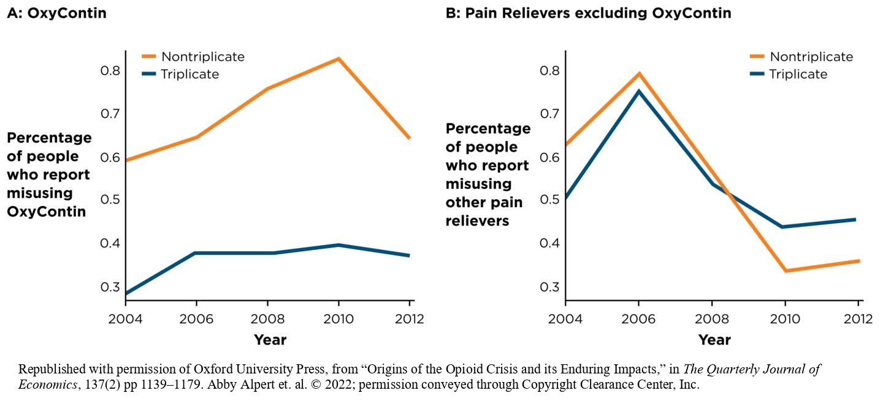
Internal Validity in Quasi-Experiments
Selection effects
Design confounds
Maturation threat
History threat
Notes:
Figure 13.6: Selection Effect for Cosmetic Surgery
The Margraf team matched people on income to rule out the possibility that people who elected cosmetic surgery were wealthier than people who decided to wait.
Blend Images/JGI/Jamie Grill/Media Bakery
Figure 13.8: Ruling Out Selection-History Effects
(A) Abuse of OxyContin was higher in nontriplicate than triplicate states, (B) but abuse of other pain relievers was the same in both nontriplicate and triplicate states. The pattern suggests that it was the aggressive marketing of OxyContin by Purdue Pharma in nontriplicate states that caused OxyContin abuse to increase, rather than demographic or political factors, which would also have affected abuse of other pain relievers, too. Misuse rates are self-reported; the sample includes U.S. residents age 12 or older. (Source: Alpert et al., 2022.)
Any time you are attempting to demonstrate a causal relationship between two or more variables, internal validity concerns must be addressed. Quasi-experiments are subject to the same threats to internal validity that true experiments are, and due to their design, sometimes we have to address these threats in novel ways.
Selection effects: This threat involves unaccounted-for differences between groups and is only relevant to independent-groups designs, not purely repeated-measures designs (like the Logic song “1-800-273-8255” study). In the Logic song study, there might be a selection effect: people who called the suicide prevention hotline during the song’s peak popularity might differ systematically from those who called at other times (e.g., they may have been more inclined to seek help). However, researchers used the same hotline over time, comparing calls across multiple time periods, which helps mitigate selection effects.
Design confounds: It’s important to monitor for extraneous variables that could influence the results. In the organ donation study, for example, presumed consent policies might coincide with other factors, such as heightened public awareness of organ donation. However, to pose a significant issue, the confounding variable would have to be systematic—affecting all seven presumed consent countries but not the four opt-in countries.
Maturation threat: Maturation threats occur when an observed change in a pretest-posttest design could have emerged spontaneously over time. For instance, in the cosmetic surgery study, participants who underwent surgery showed improvements in self-esteem, life satisfaction, and attractiveness. However, these improvements might have occurred regardless of surgery. Fortunately, the study included a comparison group, which did not improve and even showed slight declines on these measures. This design feature and the pattern of results effectively ruled out maturation as a threat to internal validity.
History Threat: A history threat occurs when an external event coincides with the treatment, making it unclear whether the outcome was caused by the treatment or the external event. For example, in Alpert et al.'s (2022) study on the opioid crisis, changes in opioid prescription rates and overdose deaths might have been influenced not only by marketing practices or laws but also by economic conditions or healthcare access. However, researchers controlled for certain history threats by examining trends across multiple states and considering external events, such as the 2010 reformulation of OxyContin to make it harder to abuse. This reformulation affected both triplicate and nontriplicate states equally, allowing researchers to rule it out as a history threat.
Republished with permission of Oxford University Press, from “Origins of the Opioid Crisis and its Enduring Impacts,” in The Quarterly Journal of Economics, 137(2) pp 1139–1179. Abby Alpert et. al. © 2022; permission conveyed through Copyright Clearance Center, Inc.

Slide 7
Quasi-Experimental Studies
What do all of these studies have in common?
Quasi-experimental: IV differentiates between groups but is not manipulated by the researcher
Notes:
If quasi-experimental studies can be vulnerable to internal validity threats, why would a researcher use one?
Real-world opportunities: The Kennedy-Hendricks team would never have been able to randomly assign states to change their pill mill laws, but they took advantage of the research opportunity that Florida provided. Similarly, Margraf and his colleagues did not manipulate the cosmetic surgery that participants did or did not receive. However, both research teams took advantage of events that occurred in real-world settings.
External validity: The real-world settings of many quasi-experiments can enhance external validity because of the likelihood that the patterns observed will generalize to other circumstances and other individuals.
Ethics: Many questions of interest to researchers would be unethical to study in a true experiment. It would not be ethical to assign elective cosmetic surgery to people who don’t want it or to assign a potentially harmful television show to young adults. but quasi-experiments can be an ethical option for studying these interesting questions.
Construct validity and statistical validity: Usually, quasi-experiments show excellent construct validity for the independent variable. In the organ donation study, countries really do have either assumed consent or opt-in policies. In the Logic song “1-800-273-8255” study, the researchers took an extra step by using social media data to verify that people were paying close attention to the song during its peak popularity in 2017, especially following high-profile performances. To assess the statistical validity of a quasi-experimental study, you could ask how large the group differences were (the effect size) and whether the results were statistically significant. You also have to evaluate how successfully the dependent variables were measured in these studies. For example, in the Logic song study, how accurately did researchers measure the increase in suicide prevention hotline calls and changes in suicide rates? Did the researchers use measures that were reliable and valid, ensuring they accurately captured the intended outcomes? Addressing these questions helps establish the statistical validity of the findings.

Slide 8
The Structure of Nonexperimental and Quasi-Experimental Designs
Nonexperimental and quasi-experimental designs often look like experiments.
  Studies produce groups of scores that can be compared for significant differences.
  No independent variable is manipulated!
    Instead, groups are defined in terms of a participant variable (e.g., gender).

Slide 9
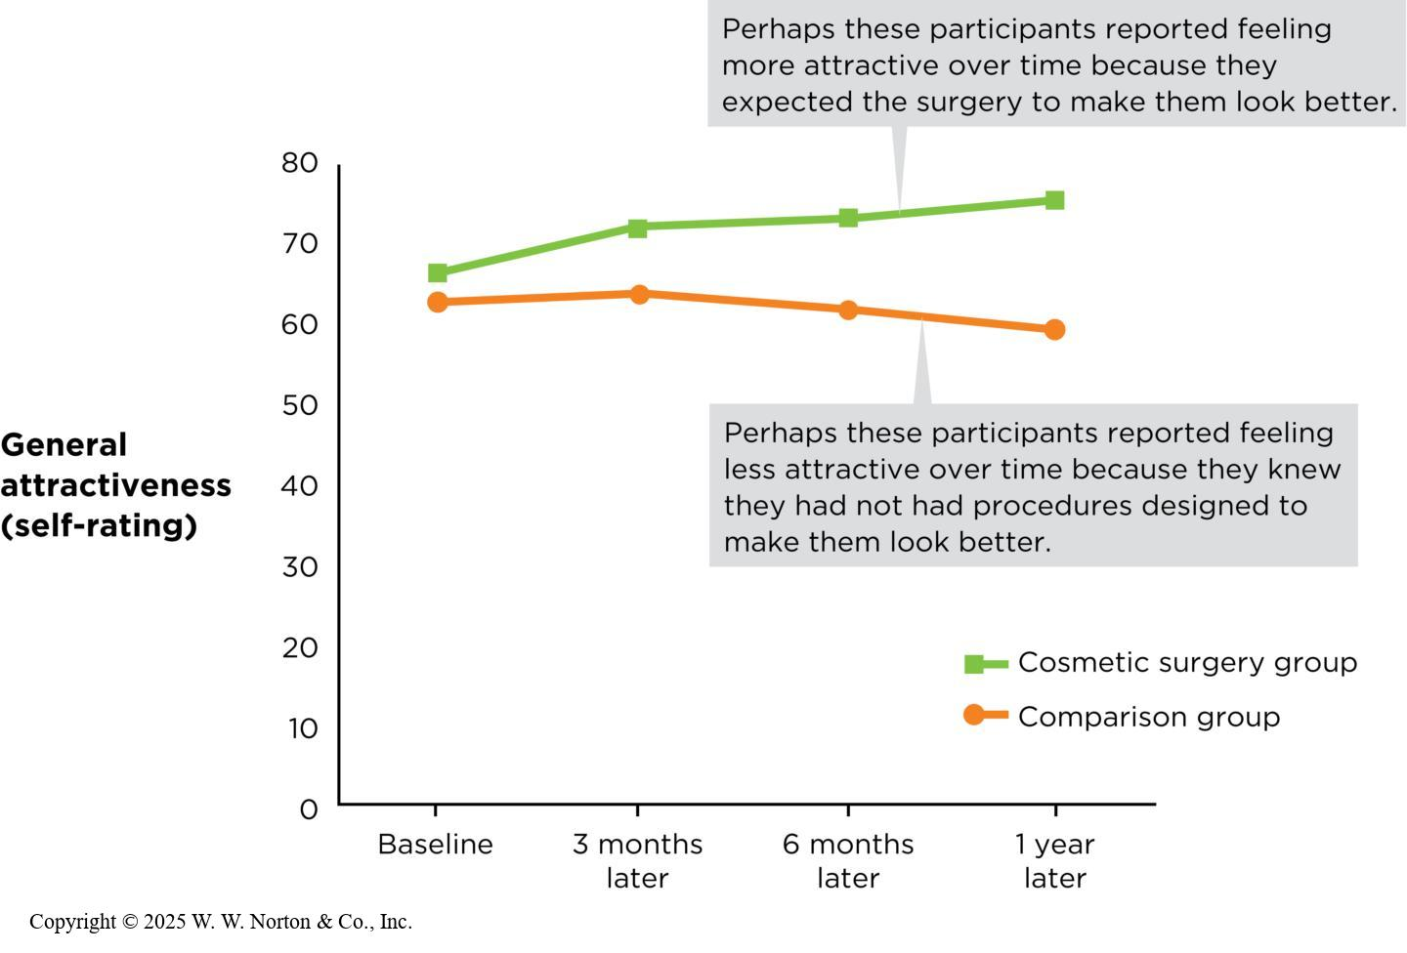
Internal Validity in Quasi-Experiments: Threats
Regression to the mean
Attrition threat
Testing and instrumentation threats
Observer bias, demand characteristics, and placebo effects
Notes:
Figure 13.9: Interrogating Placebo Effects in the Cosmetic Surgery Study
Regression to the mean: Regression to the mean occurs when an extreme finding is caused by a combination of random factors that are unlikely to happen in the same combination again, so the extreme finding becomes less extreme over time. Could regression to the mean be at play in the cosmetic surgery study?
Although this is possible, we can rule it out for two reasons: (1) The researchers did not select the surgery group because of unusually low scores at pretest; rather, they simply followed everyone who visited their targeted clinics, and (2) if regression to the mean was the explanation, those in the surgery group would have started out lower than the comparison group, but they started out the same on self-esteem and actually a little higher than the comparison group on life satisfaction and general attractiveness.
Attrition threat: In designs with pretests and posttests, attrition occurs when people drop out of a study over time. Attrition becomes a threat to internal validity when systematic kinds of people drop out of a study. Example: In the cosmetic surgery study, were people who dropped out of the study lower in self-esteem at baseline, thus inflating the results? Fortunately, attrition threats are easy to find. Margraf’s team used a missing values analysis to see if participants who dropped out of the study were systematically different from those who completed the study using the available data (they weren’t).
Testing and instrumentation threats: These threats are relevant whenever participants are measured more than once. Just as in true experiments, instrumentation threats occur when participants are not measured in exactly the same way, and testing threats occur when participants’ responses change as a result of having been tested before. Again, however, using a comparison group solves this problem. Example: If there were testing or instrumentation threats present in the cosmetic surgery study, they presumably would have affected both groups equally.
Observer bias, demand characteristics, and placebo effects: These threats to internal validity have to do with human subjectivity. In the cosmetic surgery study, observer bias is not really relevant because the study used self-report methods. However, experimental demand and especially placebo effects are of particular concern.
Look at this annotated graph of the results for the general attractiveness DV. How do we reduce the possibility of placebo effects or demand characteristics? Just as with true experiments, if we disguise the study (i.e., simply present it as a series of questionnaires) so that the participants have a hard time guessing what it is about, they might be less likely to give biased responses.
(Source: Adapted from Margraf et al., 2013.)
Copyright © 2025 W. W. Norton & Co., Inc.

Slide 10
Balancing Priorities in Quasi-Experiments
Real-world opportunities
External validity
Ethics
Construct validity and statistical validity in quasi-experiments
Notes:
If quasi-experimental studies can be vulnerable to internal validity threats, why would a researcher use one?
Real-world opportunities: The Kennedy-Hendricks team would never have been able to randomly assign states to change their pill mill laws, but they took advantage of the research opportunity that Florida provided. Similarly, Margraf and his colleagues did not manipulate the cosmetic surgery that participants did or did not receive. However, both research teams took advantage of events that occurred in real-world settings.
External validity: The real-world settings of many quasi-experiments can enhance external validity because of the likelihood that the patterns observed will generalize to other circumstances and other individuals.
Ethics: Many questions of interest to researchers would be unethical to study in a true experiment. It would not be ethical to assign elective cosmetic surgery to people who don’t want it or to assign a potentially harmful television show to young adults. but quasi-experiments can be an ethical option for studying these interesting questions.
Construct validity and statistical validity: Usually, quasi-experiments show excellent construct validity for the independent variable. In the organ donation study, countries really do have either assumed consent or opt-in policies. In the Logic song “1-800-273-8255” study, the researchers took an extra step by using social media data to verify that people were paying close attention to the song during its peak popularity in 2017, especially following high-profile performances. To assess the statistical validity of a quasi-experimental study, you could ask how large the group differences were (the effect size) and whether the results were statistically significant. You also have to evaluate how successfully the dependent variables were measured in these studies. For example, in the Logic song study, how accurately did researchers measure the increase in suicide prevention hotline calls and changes in suicide rates? Did the researchers use measures that were reliable and valid, ensuring they accurately captured the intended outcomes? Addressing these questions helps establish the statistical validity of the findings.

Slide 11
Quasi-Experiments and Correlational Studies
Both may use independent-groups designs.
Neither use random assignment.
Neither use manipulated variables.
Notes:
Quasi-experiments can look very similar to correlational studies, and indeed they do have several characteristics in common. This applies primarily to quasi-experiments with an independent-groups design. Just as in correlational studies, you are comparing two or more levels of an independent variable in order to predict one or more dependent variables.
Also, just as in correlational studies, and in contrast to true experiments, quasi-experiments do not use random assignment. Rather, researchers look for preexisting groups to study. And just as in correlational studies, the independent variable is not manipulated by researchers. But in contrast to correlational studies, researchers conducting quasi-experiments use a variety of techniques to enhance internal validity and perhaps give some evidence for causal claims.
In correlational studies, researchers simply select some people (such as a large survey sample, as in the Cacioppo et al. marital satisfaction study), measure two variables, and test the relationship between them. In quasi-experiments, however, the researchers in quasi-experiments tend to select their samples more intentionally, targeting groups with particular qualities (such as those with presumed consent and opt-in policies), target a certain time period, or seek out comparison groups provided by state laws (as in the opioid study.)

Slide 12
Quasi-Independent Variables Compared with Participant Variables
While quasi-independent variables and participant variables appear similar, there is a distinction
Studies with participant variables are intended to document similarities and differences associated with social identities.
Notes:
A participant variable is a categorical variable, such as age, gender, or ethnicity, whose levels are measured rather than manipulated. Participant variables look similar to the nonequivalent control groups of quasi-experiments because both involve measure variables that are not manipulated.
Studies with participant variables are intended to document similarities and differences due to social identities (such as gender, social class, ethnicity, religion, or sexuality), development (measured by age), or personality (such as comparing introverts to extraverts). In contrast, quasi-independent variables focus less on individual differences and more on potential interventions such as laws, media exposure, or education.

Slide 13
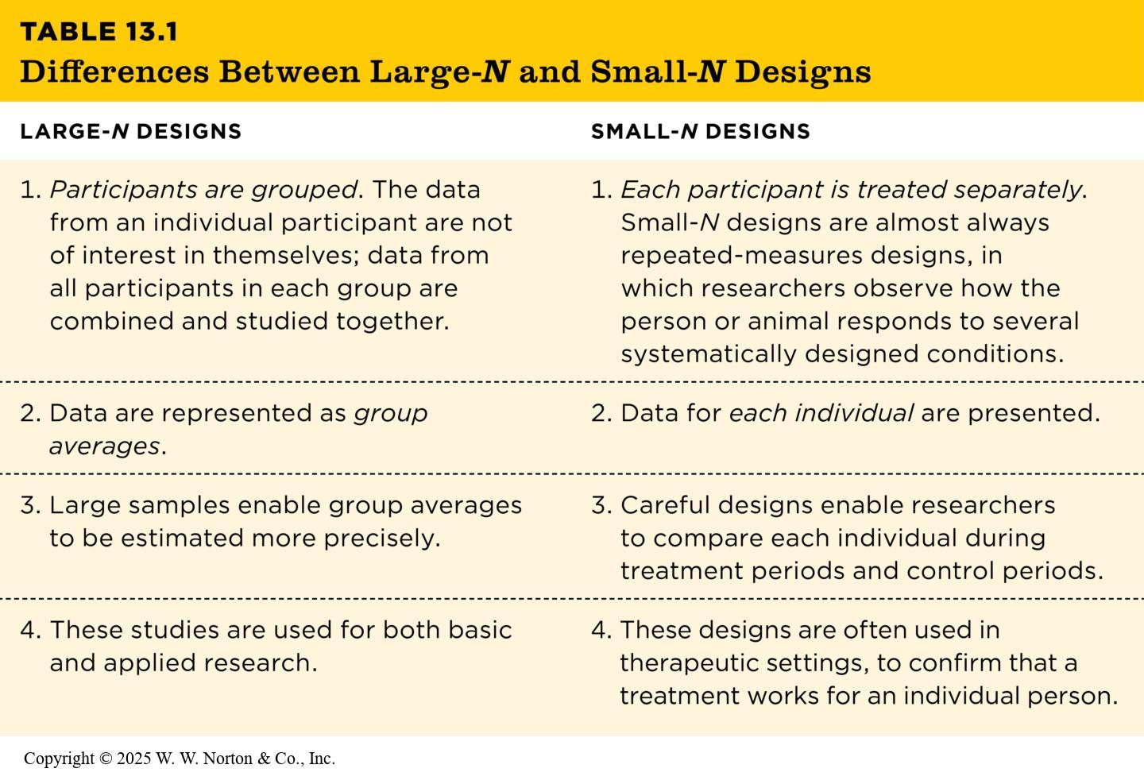
Small-N Designs: Studying Only a Few Individuals (1 of 2)
TABLE 13.1
Table 13.1 Differences Between Large-N and Small-N Designs
LARGE-N DESIGNS | SMALL-N DESIGNS
1. Participants are grouped. The data from an individual participant are not of interest in themselves; data from all participants in each group are combined and studied together. | 1. Each participant is treated separately. Small-N designs are almost always repeated-measures designs, in which researchers observe how the person or animal responds to several systematically designed conditions.
2. Data are represented as group averages. | 2. Data for each individual are presented.
3. Large samples enable group averages to be estimated more precisely. | 3. Careful designs enable researchers to compare each individual during treatment periods and control periods.
4. These studies are used for both basic and applied research. | 4. These designs are often used in therapeutic settings, to confirm that a treatment works for an individual person.
Notes:
Table 13.1: Difference Between Large-N and Small-N Designs
The small-N design: N refers to the number of subjects, or participants, in a study, so small-N studies by definition have relatively few participants, and sometimes only one.
Copyright © 2025 W. W. Norton & Co., Inc.

Slide 14
Small-N Designs: Studying Only a Few Individuals (2 of 2)
Research on human memory
Behavior-change studies in applied settings: Three small-N designs
Other examples of small-N studies
Evaluating the four validities in small-N designs
Notes:
This slide presents the section subheadings.

Slide 15
Single-Subject designs
Single-subject designs (single-case designs): research designs that use the results from a single participant
Establish the existence of cause-and-effect relationships
  Must manipulate an IV and control extraneous variables to prevent alternative explanations for the research results

Slide 16
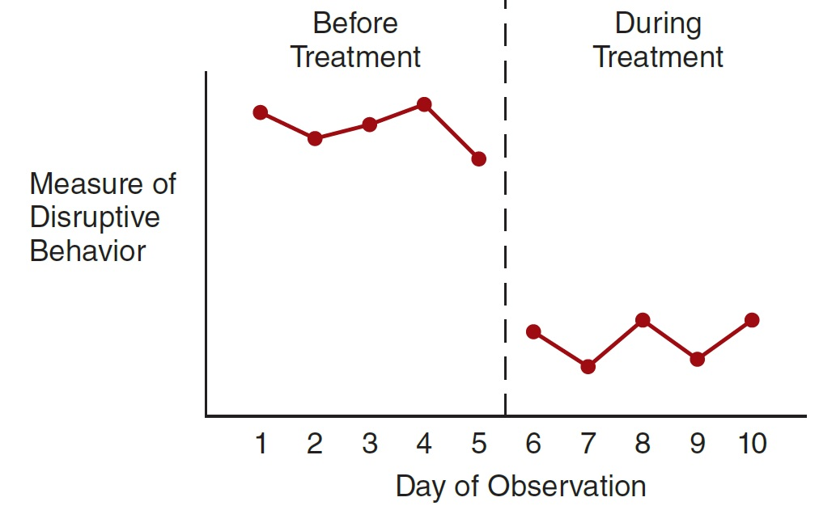
Evaluating the Results from a Single-Case Study
Data is evaluated in a simple graph since statistical tests for significance cannot be used
B
A
Notes:
However, such a graph by itself is not enough to show that the treatment caused a change in behavior
No control over extraneous variables
Could be the result of chance
Phase: series of observations of the same individual under the same conditions
Consistent level
A series of measurements ► all nearly the same magnitude
Graphed data points cluster around a horizontal line
Consistent trend
Differences from one measurement to the next ► consistently in the same direction and nearly the same magnitude
Graphed data points cluster around a sloping line
The degree to which the observations show a pattern of consistent level or consistent trend
Stable data may show minor variations from a perfectly consistent pattern
Variations should be relatively small and the linear pattern relatively clear

Slide 17

Example: Research on Human Memory
Henry Molaison suffered from repeated, debilitating epileptic seizures.
A surgeon excised the front half of his hippocampus on both the right and left sides
Notes:
Figure 13.10: Case Studies Show Separate Memory Systems
Henry Molaison (right) got better every day at a mirror-tracing task (nondeclarative memory), even though he claimed each day that he’d never seen the task before (declarative memory).
The surgery was successful in that it dramatically reduced Henry’s seizures. But as he was recovering, his family and medical staff noticed he didn’t recognize the nurses and doctors caring for him. He remembered his parents and could recall memories from before his surgery with varying levels of detail. Yet he’d seemingly lost the ability to learn anything new. By studying Henry and patients with similar surgeries, Scoville and Milner learned that bilateral hippocampal lesions do not affect intelligence or personality, but they do affect (1957) the ability to form new memories.
Milner, and later Suzanne Corkin and her colleagues, studied H.M. extensively over more than 40 years. The tasks they developed, along with the patient’s gracious participation, helped document the biological separation between declarative memory, or knowing that something happened, and nondeclarative memory, knowing how to do something.
For instance, Corkin’s group taught Henry to trace a star pattern with a pencil while seeing his hand only in a mirror (Corkin, 2013). Over repeated trials, his mirror-tracing skill improved just as quickly as that of a control participant with an intact brain (this was his nondeclarative, “knowing how” memory). But each day when he saw the task, he’d claim he’d never tried it before (his declarative, “knowing that” memory).
(left): From NOVA ScienceNow, How Memory Works; (https://www.pbs.org/wgbh/nova/article/corkin-hm-memory/) © 1997-2024 WGBH Educational Foundation; (right): Henry Molaison, aged 60, at MIT in 1986. Photograph by Jenni Ogden, author of book “Trouble in Mind: Stories from a Neuropsychologist’s Casebook”

Slide 18
Research on Human Memory (continued)
Balancing priorities in case study research
    Experimental control, manipulation, and replication
    Studying special cases
Disadvantages of small-N studies
Notes:
How convinced should we be by the results of research on special cases such as H.M.? These studies, after all, were conducted with only a small number of participants.
Experimental Control: Case studies can effectively advance our knowledge when researchers use careful research designs. Because of the empirical strengths of these studies, we can, in fact, make some conclusions. First, Corkin and her colleagues used the power of experimental control. In some cases, such as testing Henry’s ability to remember numbers or recognize magazine photos, researchers compared his performance to age-matched control participants who had no brain damage. Second, researchers deliberately designed tasks meant to isolate different elements of memory, such as declarative from nondeclarative memory.
Studying Special Cases: Just as quasi-experiments can take advantage of natural accidents, laws, or historical events, small-N studies often take advantage of special medical cases. Studying people like Henry Molaison gave researchers the opportunity to test which kinds of tasks require hippocampal regions and which do not, under controlled conditions.
Disadvantages of small-N studies: Henry’s cerebellum was also damaged from antiseizure medications. The multiple types of damage make it more difficult to narrow down the specific region responsible for each behavioral deficit—an internal validity issue.
Another disadvantage involves external validity: Participants in small-N studies may not represent the general population very well. We cannot be sure whether results from studies on surgery patients would apply to people with no history of epilepsy or schizophrenia. Furthermore, it clearly would be unethical to remove regions of the brain of a person without epilepsy or schizophrenia to create the necessary comparison.

Slide 19
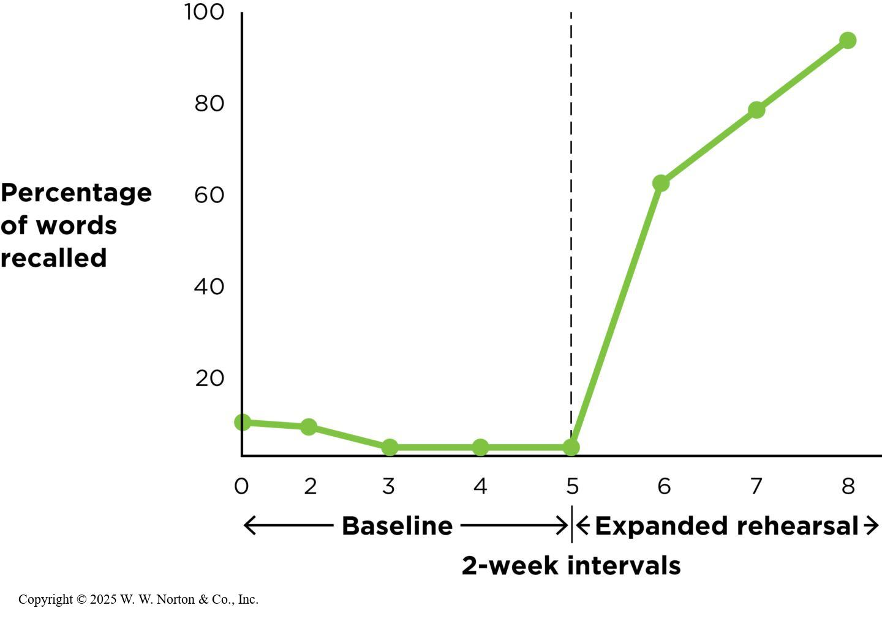
Behavior-Change Studies in Clinical Settings: Three Small-N Designs (Stable-Baseline)
Stable-baseline designs
Notes:
Figure 13.12: Using a Stable-Baseline Design
In this study, the patient’s memory was consistently poor until the new expanded rehearsal technique was introduced; then it dramatically improved. (Source: Adapted from Moffat, 1989.)
Another use of small-N designs is to evaluate the efficacy of a treatment or intervention. In the following three studies we’ll be looking at treatments designed to modify the behaviors of certain individuals to produce a desired result.
The first is an example of a stable-baseline design. This is a study design in which a researcher observes a behavior for an extended “baseline” period before the intervention or treatment is introduced. If this baseline is stable and the target behavior only changes after the treatment, then we can be more certain of its effectiveness.
The example we’ll discuss looks at the effectiveness of an expanded rehearsal technique to enhance word recall in an Alzheimer’s patient, Ms. S (Moffat, 1989). As you can see in the figure, there a low stable baseline of behavior (recall) was measured for several weeks before the intervention occurred.
Once the new expanded rehearsal technique was introduced, Ms. S’s recall rapidly and dramatically increased. Measuring this stable baseline for an extended period is crucial to the internal validity of this type of study. It allows us to rule out other explanations for effects, such as spontaneous change (maturation), or regression. Then, we can use replication to further enhance our causal claims.
Copyright © 2025 W. W. Norton & Co., Inc.

Slide 20
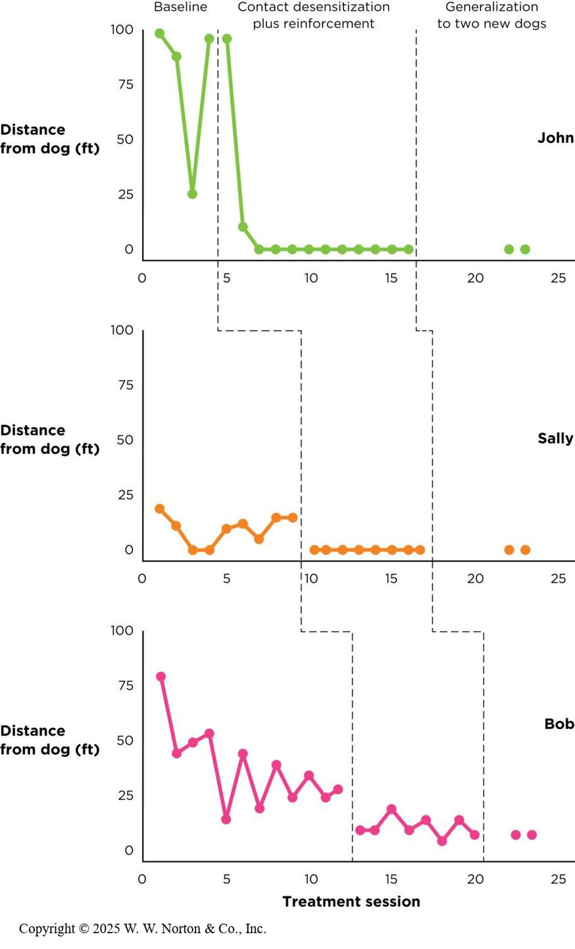
Behavior-Change Studies in Clinical Settings: Three Small-N Designs (Multiple-Baseline)
Multiple-baseline designs
Notes:
Figure 13.14: Using a Multiple-Baseline Design
In this study, three children with autism who feared dogs initially stayed a long distance from a dog on the far side of a gym. After several sessions of therapy in which they were praised for moving closer and closer to the dog, all three children showed dramatic improvements in their willingness to approach the training dog and, later, two new dogs. (Source: Adapted from Tyner et al., 2016.)
The second example uses a multiple-baseline design. In this type of study, researchers stagger their interventions across situations, times, or contexts.
Example: Three different children with autism who feared dogs initially stayed a long distance from a dog on the far side of a gym. After several sessions of therapy in which they were praised for moving closer and closer, all three children showed dramatic improvements in their willingness to approach the training dog, and then later, two new dogs. (Source: Adapted from Tyner et al., 2016.)
Copyright © 2025 W. W. Norton & Co., Inc.

Slide 21
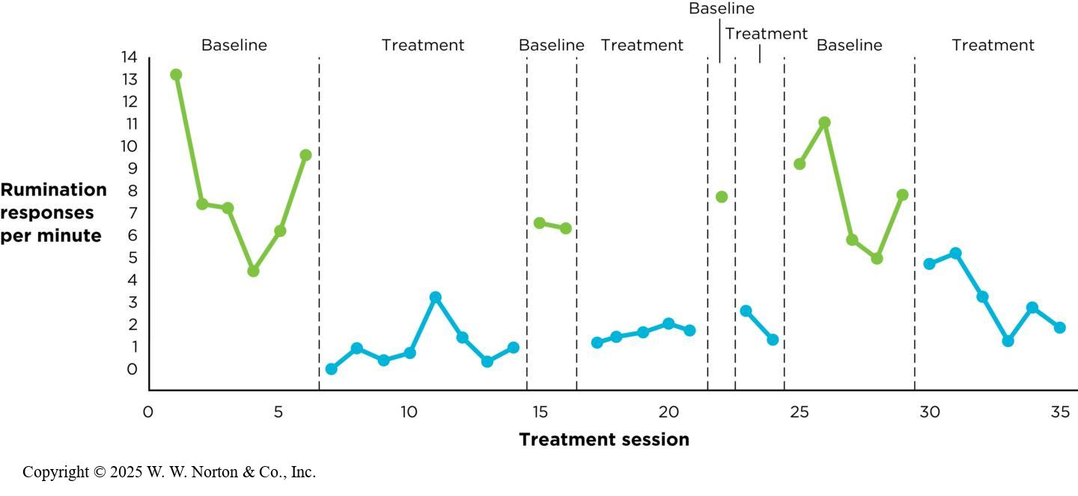
Behavior-Change Studies in Clinical Settings: Three Small-N Designs (Reversal)
Reversal designs
Notes:
Figure 13.15: Using a Reversal Design
In this study, the client’s rumination behavior was high during baseline sessions and lower during treatment sessions. This pattern supports the idea that the treatment caused his rumination to decrease. (Source: Adapted from DeRosa et al., 2016.)
The third behavior-change example uses a reversal design. In this type of study, researchers usually observe a baseline of behavior before treatment, next observe the behavior during treatment, and then remove the treatment to see whether the behavior reverts back (the reversal period).
Example: In this study, the client’s rumination behavior was high during baseline sessions and lower during treatment sessions. This pattern supports the idea that the treatment caused his rumination to decrease. (Source: Adapted from DeRosa et al., 2016.)
Reversal designs are appropriate mainly for situations in which a treatment may not cause lasting change. Perhaps because of his disabilities, Darnell’s rumination seemed to be automatically reinforcing to him, which is probably why the behavior returned during baseline sessions.
In contrast, reversal designs would not make sense to use for an educational intervention. Once a student has learned a new skill (such as Ms. S’s expanded rehearsal technique), it’s unlikely the skill would simply reverse or disappear.
Copyright © 2025 W. W. Norton & Co., Inc.

Slide 22
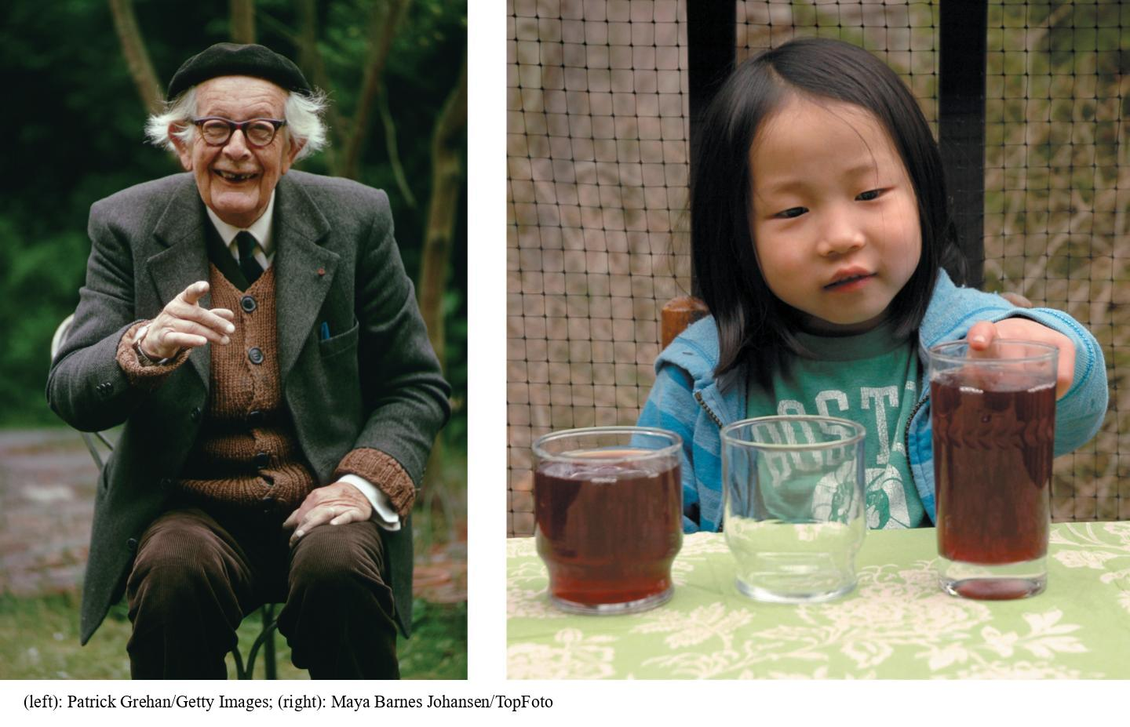
Other Examples of Small-N Studies: Piaget
Piaget and child development
Notes:
Figure 13.16: Using a Small-N Design to Study How Children Think
Piaget (left) tested his theories of child cognitive development by systematically testing his own children (not pictured) on carefully constructed tasks, such as estimating which glass “has more.”
Jean Piaget (1923) was a developmental psychologist who was interested in cognitive development in children. He developed his theory in large part through careful observations of his own three children. Ideas like conservation of liquid (illustrated in the figure), in which younger children think there is more liquid when it is poured into a taller but more slender glass, came from these observations. Although three is obviously a very small N, Piaget used very careful, systematic observation, well-defined constructs, and extensive replication to support his conclusions.
(left): Patrick Grehan/Getty Images; (right): Maya Barnes Johansen/TopFoto

Slide 23
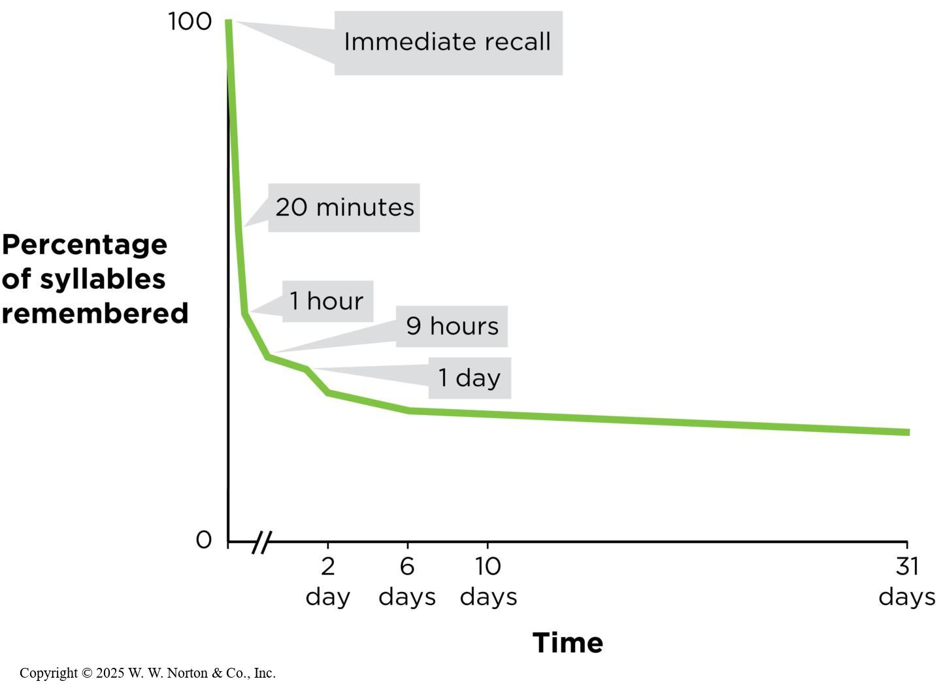
Other Examples of Small-N Studies: Ebbinghaus
Ebbinghaus and the forgetting curve
Notes:
Figure 13.17: A Single-N Design: The Forgetting Curve
Ebbinghaus’s carefully designed experiments on memory processes contributed to psychology, even though he used only one person—himself—as a subject.
Hermann Ebbinghaus (1913) was an experimental psychologist who conducted a series of memory studies. He made himself memorize long lists long lists of nonsense syllables, such as “pon” and “mip,” and then documented how many syllables he remembered at different time intervals. This figure illustrates the forgetting curve described by Ebbinghaus. These studies had an N of just one: the researcher himself. But again through precise experimental control and measurement, and careful replication, these studies became a great contribution to the field.
Copyright © 2025 W. W. Norton & Co., Inc.

Slide 24
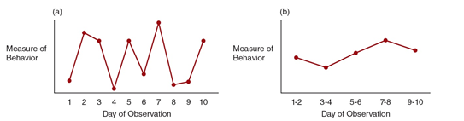
Dealing with Unstable Data
Notes:
Strategies:
Wait until the data stabilize
Average a set of two or more observations
Look for patterns within the inconsistence

Slide 25
Evaluating the Four Validities in Small-N Designs
Internal validity
    Can be very high if the study is carefully designed
External validity
    Can be problematic depending on the goals of the study
Construct validity
    Can also be very high if definitions and observations are precise
Statistical validity
    Not always relevant to small-N studies
Notes:
Internal validity: The examples in this chapter are all of very well-constructed studies. For the reasons we discussed, the internal validity of all of them is relatively good.
External validity: On the one hand, this is easy to criticize in small-N designs, but on the other hand, the goals of the research are not always to generalize to other populations. Example: Medical studies on treatments for rare illnesses necessarily have a small number of participants, but if the goal of such research is only to treat that rare disease, then generalization is not relevant. Research can take steps to maximize the external validity of their findings. They can triangulate by combining the results of single-N studies with other studies on animals or other groups, as the team did when comparing H.M.’s results with subsequent research on people without brain damage.
Construct validity: No matter what kind of study you are conducting, you must always be careful to define your variables well. Construct validity is fairly straightforward when researchers are recording whether a person with a brain lesion reports seeing this picture or that one, and for objective measures such as memory for a string of numbers. But when researchers are recording how close a child gets to a dog or whether a person is ruminating, they should use multiple observers and check for interrater reliability, in case an observer is biased or the behavior is difficult to identify.
Statistical validity: Due to their unique design, small-N studies often do not rely on traditional parametric statistics to draw their conclusions. Often the effect is so strong that simply looking at a visual summary of the results (such as the graphs for the behavioral change studies) is enough to convey the power of the experimental manipulation. However, researchers should always be careful to treat data appropriately when drawing conclusions.

